Slide 1
Ezekiel 1-3
“I got up and went out to the plain; and behold, the glory of the LORD was standing there, like the glory which I saw by the river Chebar, and I fell on my face.” (Ezekiel 3:23)

Slide 2
The Chariot of God (1:1-28)
The focus should not be the mechanics, but the message conveyed.
The Cloud (1:4)
The Cherubim (1:5-14)
The Wheels (1:15-21)
The Expanse (1:22-25)
The Throne (1:26-28)

Slide 3
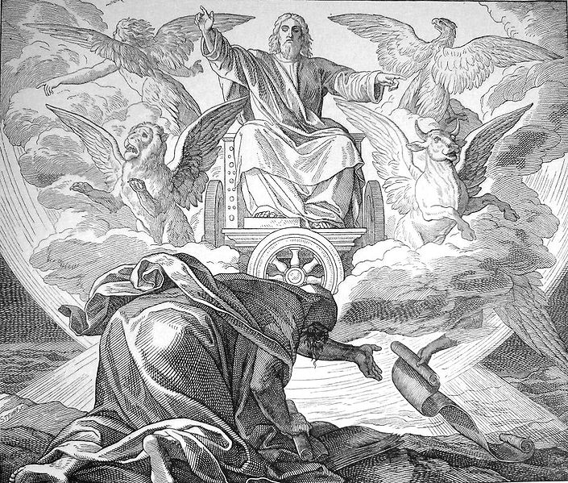

Slide 4
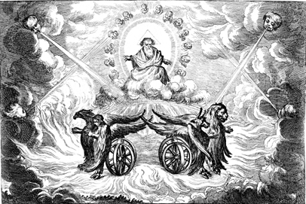

Slide 5
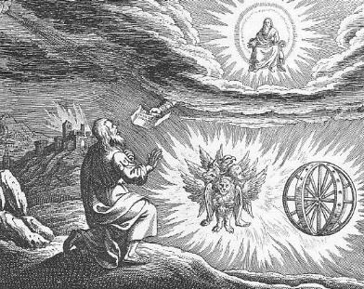

Slide 6
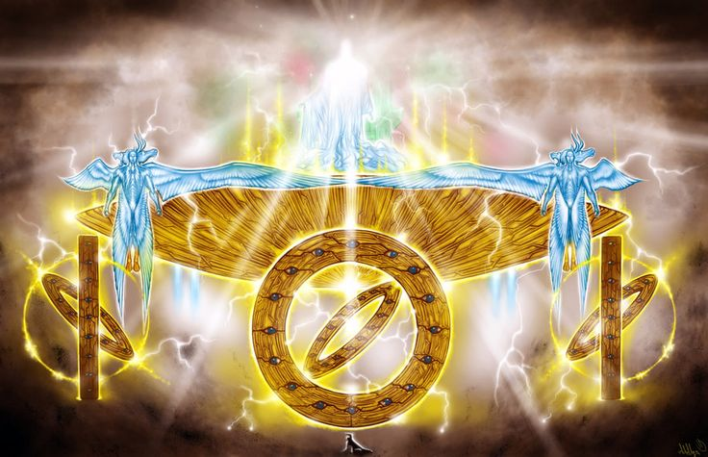

Slide 7
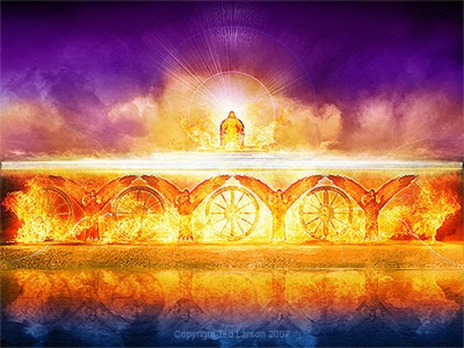

Slide 8
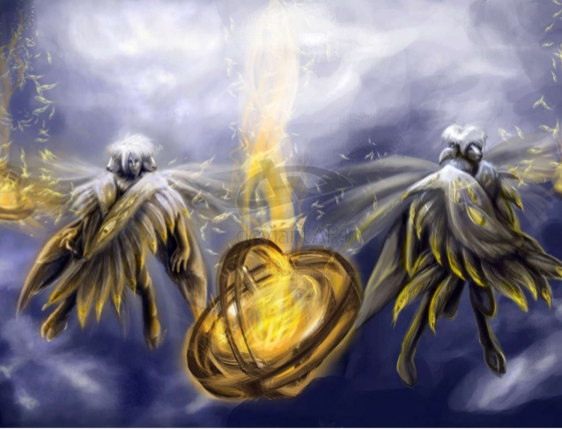

Slide 9
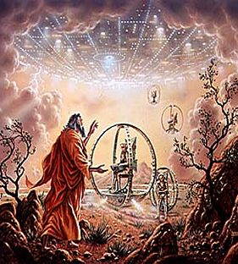
Alien Spaceship??

Slide 10
The Call of God (2:1-3:3)
God calls Ezekiel to service as a prophet.
The Mission (2:1-7)
The Message (2:8-3:3)

Slide 11
“son of man” (2:1)
God calls Ezekiel “son of man” first in 2:1 and over 90 more times….
What is the significance of this (if any)?
Daniel called “son of man” (Daniel 8:17)
Others called “son of man” (Numbers, Job, Psalms, Isaiah)
Messianic use in the scriptures:
Psalm 8:4, Hebrews 2:6-9 also Daniel 7:13-14
Jesus called himself the “Son of man” over 80 times.

Slide 12
What about Ezekiel the “son of man”?
What is the significance of this (if any)?
Reminder of his human frailty? Statement of fact? Not in divine sense.
Type-Antitype (1 Peter 1:20-21)? Was Ezekiel a “type” of the coming Savior?
He was a godly priest and scribe…
An obedient servant of God sent to a rebellious people…
Sent to “call out” a people with the right hearts….
Others?

Slide 13
The Commission of God (3:4-27)
A fourfold commission follows the Divine call. Emphasis is on Ezekiel’s obligation to speak God’s word. Ezekiel was called to be…
A Preacher (3:4-9)
An Observer (3:10-15)
A Watchman (3:16-21)
A Prisoner (3:22-27)

